Slide 1

Human or Bot
Loo Yang Kai, Wu Jiafang, Chu Wei Quan, Ong Guang Qi, Sze To Brennan

Slide 2
Business Problem
GENERAL TREND
With the growth of technology and tools, online auction sites face the problem of an increasing number of software-controlled bots performing bids.
This trend has created an issue for bidders
Machine learning resolves this issue in an efficient way
Without Machine Learning:
Extremely cost inefficient to manually analyse millions of bid information and faces a high risk of human error
With the increase in bots, human bidders often face an issue of being out bided by bots.
e.g. Limited-edition clothes and concert tickets
With Machine Learning: Process millions of rows quickly, understanding features/bidding behaviour of a bot and able to able to promptly flag bids made by bots

Slide 3
Machine Learning Models
Models
Why it was used
Decision Tree
Easier to interpret and understand as compared to many other models
Requires minimal preparation or data cleaning before use
XGBoost
Builds one tree at a time & combines results along the way
Try to reduce the bias of the weak learners by reducing the prediction error of badly classified observations at each step
Random Forest
Randomized feature selection makes random forest much more accurate than a decision tree as it chooses features randomly during the training process & does not depend highly on any specific set of features
ANN
The dataset provided seems to be distinct and complex because of the many possible scenarios. Therefore, a neural network may be helpful to find non-direct patterns.
Metrics Used
Accuracy
Measures the accuracy of the model in identifying bots
1
AUC ROC
Measures performance of the model at distinguishing between the positive and negative classes
2
FBeta
Provides a configurable version of the F-measure to give more or less attention to the precision and recall measure when calculating a single score
3

Slide 4
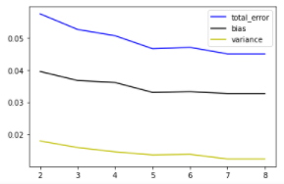
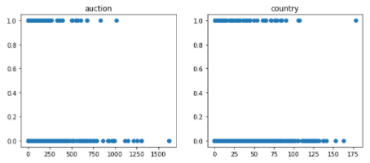
Business Problem (Initial Data and Predictions)
INITIAL FEATURES PROVIDED
Bid_id, Bidder_payment_address, Address, Bidder_id, Auction, Merchandise, Device, Time, Country, Ip, Url
Initial Results of the base models with 8 features
Initial Results of the Xgboost model with the initial 8 features
Initial Results of scatterplot for auction & country feature
Model | DT | RF | XGB | ANN
Accuracy | 0.9354 | 0.9603 | 0.9619 | 0.8626
ROC AUC | 0.6109 | 0.8841 | 0.8507 | 0.3264
Fbeta | 0.3261 | 0.2174 | 0.4032 | 0.1437
Conclusion: Preliminary results shows high error and bias, low ROC AUC and Fbeta score within the dataset. The labels of bots and humans are clustered around the same region.

Slide 5
Machine Learning Models
Techniques
Why it was used
How it is applied
Resampling
Helps to deal with class imbalance by generating synthetic samples for the minority class, helps to overcome the overfitting problem posed by random oversampling
RandomUnderSampling to reduce number of examples for the majority class.
Run a pipeline using SMOTE and RandomUnderSampling for training dataset as performing them both together helps to increase the effectiveness of handling imbalanced classes
Stratified K Fold
Equally splits the minority classes for the train and test set for each fold
More representative of actual accuracy as Kfolds provide better approximation for that accuracy, including less overfitting
Maximize our training dataset by splitting them into k number of folds and training them
Used in gridsearch, randomsearch, evaluation of scores of the final models & stacking
Feature Elimination
Having many features creates a highly complex model, which tends to overfit to the training data
Eliminating features also helps to improve interpretability of the model and computational efficiency
Leveraging on the feature importance

Slide 6
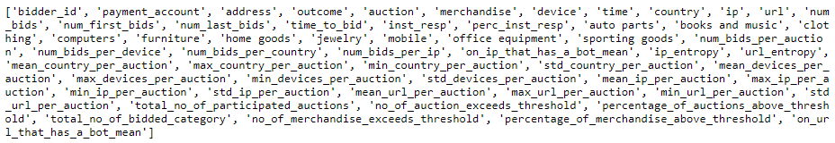
Feature Engineering
Usable Features
Bidder_id, Auction, Merchandise, Device, Time, Country, Ip, Url
Engineered 52 features through one hot encoding, log entropy and statistical measures

Slide 7
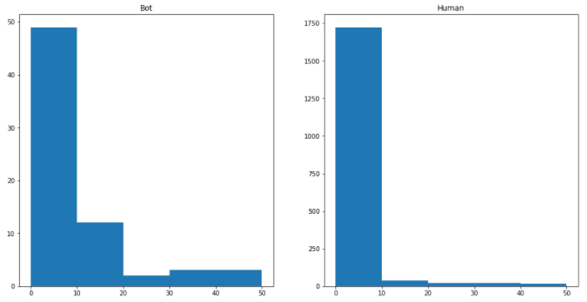
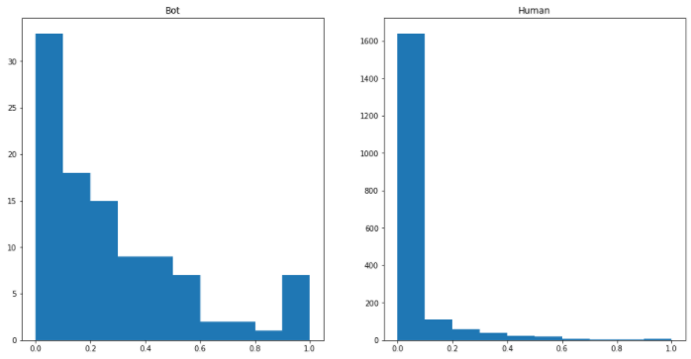
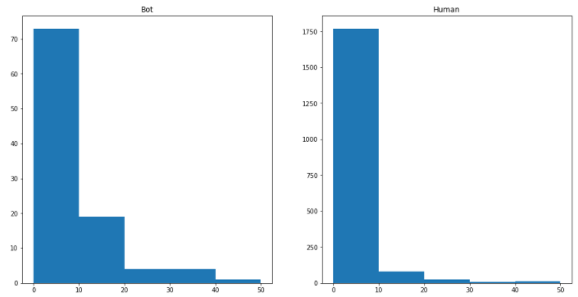
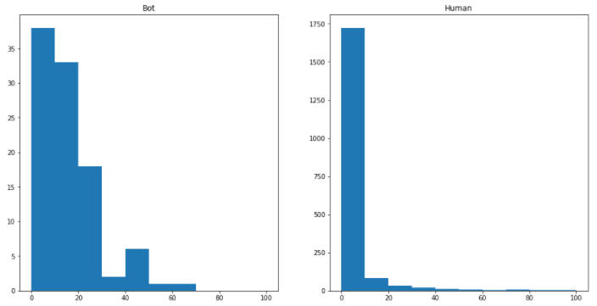
Feature Engineering (Interesting Features)
Bot
Human
Bot
Human
1
3
Feature Name: Instant response
Feature Name: Percentage of auctions above threshold
Description: Number of Simultaneous response
Description: % of auctions bidder bidded above the average no. of bids for an auction
Bot
Human
Bot
Human
2
4
Feature Name: Mean IP used per auction
Feature Name: Number of bids per auction
Description: Mean no. of IP used by per bidder in an auction
Description: Total no. of bids per bidder per auction

Slide 8
Hyperparameters Tuning (Finding the best hyperparameters)
FUNCTIONS USED
Finding the best model: model.best_estimator_
Finding the parameters of the best model: model.get_params_
Approaches to finding the best parameters
1
Finding out the base model’s performance
3
Using GridSearchCV to further narrow down to find the best parameters for the model and find out the best model’s performance
Model | DT | RF | XGB | ANN
Accuracy | 0.8977 | 0.9319 | 0.9359 | 0.8808
ROC AUC | 0.7312 | 0.9000 | 0.9052 | 0.2998
Fbeta | 0.4436 | 0.5239 | 0.5163 | 0.1024
Model | DT | RF | XGB | ANN
Accuracy | 0.8957 | 0.9536 | 0.9487 | 0.8560
ROC AUC | 0.8106 | 0.8934 | 0.8895 | 0.7055
Fbeta | 0.3824 | 0.5396 | 0.5 | 0.3788
Base Performance Measure
2
Using RandomSearchCV to retrieve the best parameters for the model and find out the best model’s performance
Grid Search Performance Measure
Model | DT | RF | XGB | ANN
Accuracy | 0.8957 | 0.9536 | 0.9520 | 0.8543
ROC AUC | 0.8106 | 0.8943 | 0.8807 | 0.7871
Fbeta | 0.3824 | 0.5396 | 0.5634 | 0.4589
Random Search Performance Measure

Slide 9
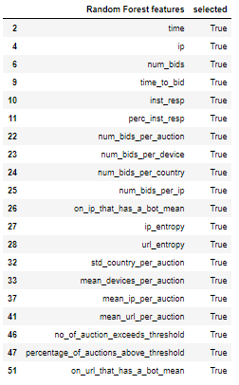
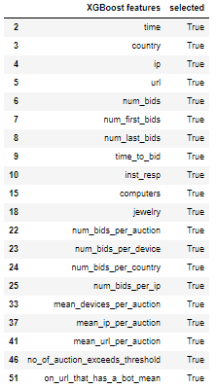
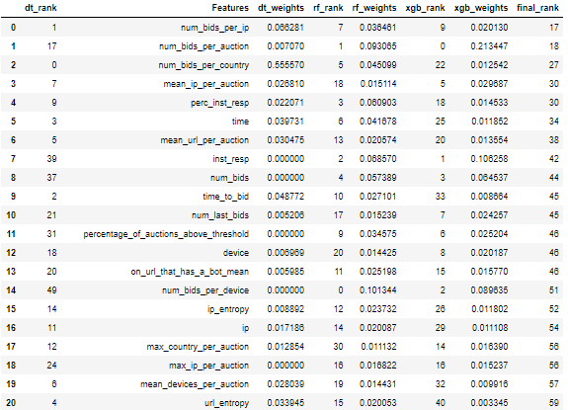
Feature Selection (Approaches)
RFE
Combined ranking of each model feature
PCA
Pros – models will perform their best predictions
Cons – difficult to make a fair comparison between other models
Pros – model’s performance based on same set of features, easier to make a fair comparison
Cons – some models might suddenly perform much worse when certain features are removed
Pros – relevant in cases where features with most variation are most important
Cons – only relevant in the cases where the features with most variation are the ones most important to your problem statement and this must be known beforehand

Slide 10
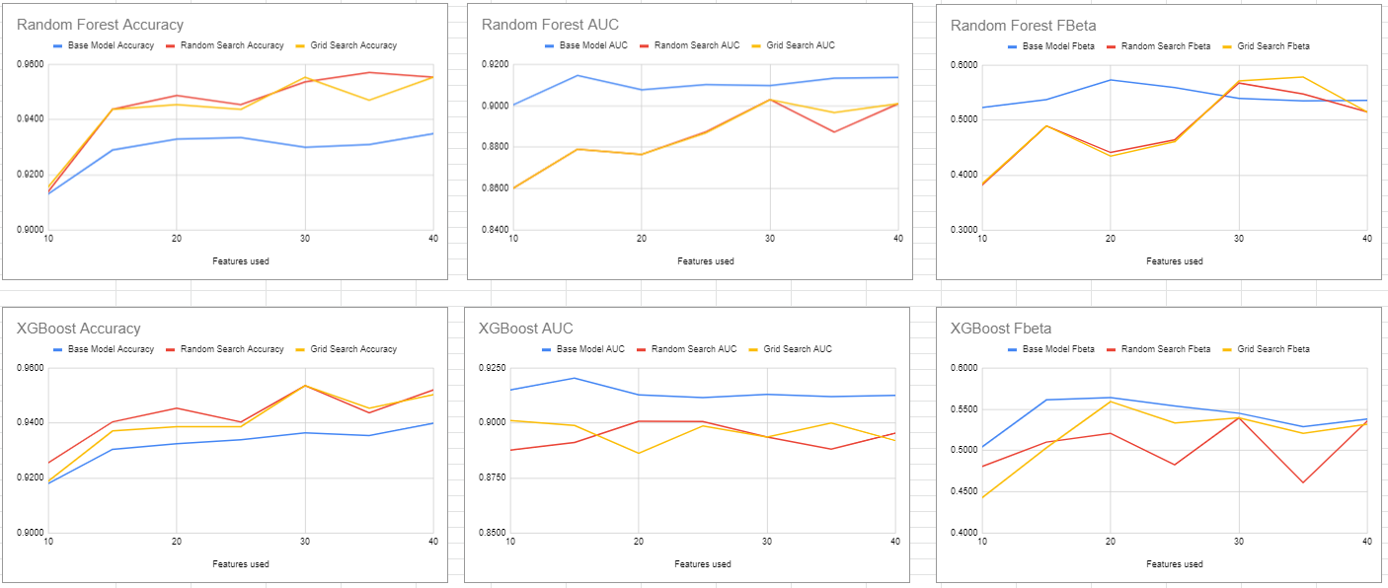
Feature Selection (Results)
Based on our best models, XGBoost and RandomForest which have the most consistent trend, we have decided to go ahead with 30 features as 35 features generally show a huge dip in the the performance metrics

Slide 11
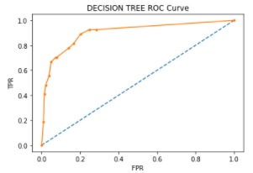
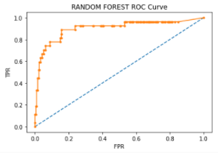
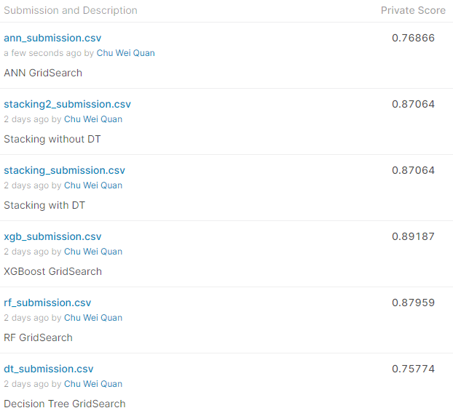
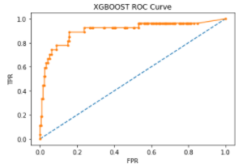
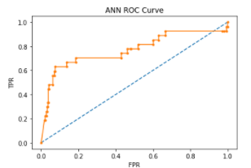
Final Model (Best parameters & Performance Metrics)
Original
All Features
Final Features
Model | DT | RF | XGB | ANN
Accuracy | 0.9354 | 0.9603 | 0.9619 | 0.8626
ROC AUC | 0.6109 | 0.8841 | 0.8507 | 0.3264
Fbeta | 0.3261 | 0.2174 | 0.4032 | 0.1437
Model | DT | RF | XGB | ANN
Accuracy | 0.8957 | 0.9536 | 0.9487 | 0.8560
ROC AUC | 0.8106 | 0.8934 | 0.8895 | 0.7055
Fbeta | 0.3824 | 0.5396 | 0.5 | 0.3788
Model | DT | RF | XGB | ANN
Accuracy | 0.8841 | 0.9553 | 0.9536 | 0.9007
ROC AUC | 0.9029 | 0.9029 | 0.8936 | 0.7698
Fbeta | 0.5236 | 0.5714 | 0.5396 | 0.4857
Random Forest Params
bootstrap: False,
max_depth: 90,
max_features: auto,
min_samples_leaf: 2, min_samples_split: 5,
n_estimators: 1100
Kaggle Results
Decision Tree Params
criterion: 'entropy’,
max_depth: 50,
max_features: 25,
min_impurity_decrease: 0.0005,
min_samples_leaf: 21,
min_samples_split: 7
XGBoost Params
colsample_bytree: 0.8,
gamma: 0.3,
max_depth: 4,
min_child_weight: 1,
subsample: 0.9
ANN Params
batch_size: 10,
epochs: 100,
learn_rate: 0.1,
momentum: 0.2

Slide 12
Explanation for Model Performance
Model
Why is XGBoost the best model from our results?
Overfitting is possible even when the training data are noise-free, possible for coincidental regularities to occur, in which some attribute happens to partition the examples very well, despite being unrelated to the actual target function
When using an imbalanced dataset (i.e. where one class of data dominates over another) it is easy for outcomes to be biased in favor of the dominant class
Generally, decision trees provide lower prediction accuracy compared to other predictive algorithms
Decision Tree
ANN
As our dataset is rather small, ANN's performance may be limited due to the lack of data as neural network requires large dataset
Random Forest
Not as great at imbalanced classification problems
Tends to perform well for multi-class object detection and bioinformatics, which tends to have a lot of statistical noise
XGBoost
Performs well when you have unbalanced data
When the model fails to predict the anomaly for the first time, it gives more preferences and weightage to it in the upcoming iterations thereby increasing its ability to predict the class with low participation
XGBoost straight away prunes the tree with a score called “Similarity score”
Able to overcome overfitting issue to a great extent through stopping the construction of the tree to a greater depth if the gain from a node is found to be minimal

Slide 13
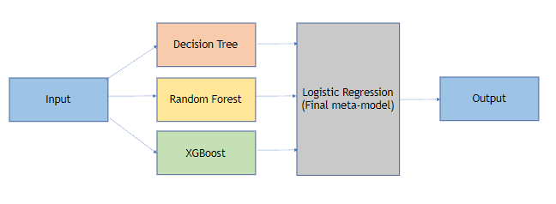
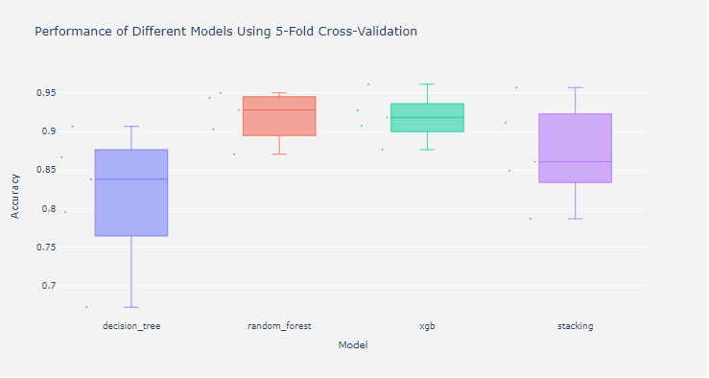
Final Model (Stacking)
Stacking Implementation
Utilizing the best estimators for Decision Tree, Random Forest, XGBoost
LogisticRegression as the meta model
Models are scored using cross_val_score
Passthrough set to True for the stacking classifier, allowing the classifier to access the training data as well
Reasons why our Stacking Classifier did not turn out well
Model diversity may have been one consideration we did not factor in as we should have consider what new information each model brings into the table.

Slide 14
Comparison of Techniques
Scenarios
Detailed Explanation of Steps
1
Multi Class & Balanced Dataset
Using a multi-class and balanced dataset, Random Forest is expected to perform better as Random Forest models handles multi-class datasets better than XGBoost.
As random forest was not designed to handle imbalanced datasets, with a balanced dataset, it can be expected that Random Forest may perform better
2
Larger set of dataset
With a larger set of data, the ANN model may perform better and outperform the decision tree model. A general rule of thumb for dataset size for ANN model is to use fifty to a hundred times of the number of features for a model.
3
Non obfuscation of the time variable
The current dataset obfuscates the time variable in the dataset. Without the obfuscation, we will be able to better interpret and feature engineer more useful features, which will improve the predictions of the models.
Notes:
but due to obfuscation of the time variable there is not much we can do with it

Slide 15
Challenges & Insights gained
Challenges
Learning Points
1
Determining the number of features to use
1
Importance of data set selection
Difficult to determine how many features we should use for our models, as accuracy fluctuates for different models and for different number of features
Important to select datasets that provides good data & data points that our team will be able to understand
After conducting further analysis, we realised that it was difficult for our team to make sense of the time data points
2
Determining overfitting/underfitting of a model
2
Importance of feature extraction
Difficult to determine whether a model is overfitted or underfitted as training dataset has SMOTE applied to it while test data does not have SMOTE applied to it
Data cleaning and feature extraction is the most important portion of a ML/data science cycle
Without good features and feature engineering, the model will not deliver good results
3
Feature Engineering
3
Importance of handling imbalanced datasets well
Time is an important feature to determine whether a bidder is a bot. However, we were not able to interpret the time data, which affected the accuracy of our model
Our team also found it difficult to come up with new features
As some models does not handle imbalanced datasets well, we realised that models that handles imbalanced datasets better than other models tend to perform better
4
Compatibility of models
ANN was not compatible with many of the experiments we wanted to carry out, thus, making it hard for us to compare ANN with the rest of the models
Notes:
Use bias of the dataset as a challenge?
Choosing the feature selection technique within time constraints
ANN was not compatible with much of the experiments we wanted to carry out
Difficult to come up with new meaningful features

Slide 16

THANK YOU
Please feel free to ask us any questions!

Slide 17
Decision Tree
Logistic Regression
(Final meta-model)
Input
Random Forest
Output
XGBoost

